Slide 1
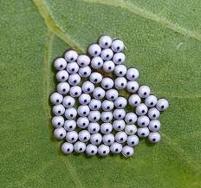
Egg
March 30, 2015
the first stage in the life cycle of many organisms

Slide 2
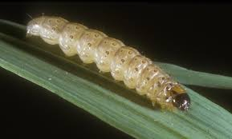
March 31, 2015
Larva
the stage of change when an organism resembles a worm temporarily

Slide 3
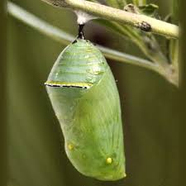
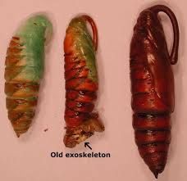
April 1, 2015
Pupa
the stage in which an organism seems to be at rest and forming a new body

Slide 4
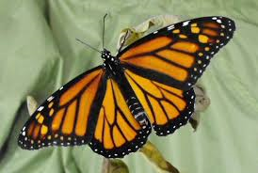
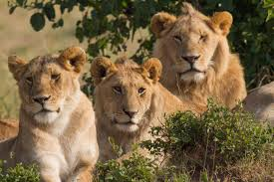
Adult
April 2, 2015
a fully grown organism that can reproduce

